Slide 1
Coursera Capstone
IBM Applied Data Science Capstone
Exploring the best place of the city to visit in Hyderabad , India
By: Chitta Voina Arthi
September 2019

Slide 2
Business Problem
Exploring the venues based on the users specified interest is one of the most important decisions
Objective : To analyse and select the best locations in the city of Hyderabad to explore.
Hyderabad with its unmatched blend of history and modernity, hypnotizes everyone, whoever sets his/her foot in this beautiful city of Nizams.
Business Question : If a person wants to explore an unknown place based on what parameters he does and from where?

Slide 3
Data Information
Data required :
List of neighbourhoods in Hyderabad
Latitude and Longitude coordinates of the neighbourhoods
Venue data
Sources of data :
From Foursquare API (https://developers.zomato.com/api), retrieve the information for each venue .
From Zomato API (https://developers.zomato.com/api), retrieve the information for each venue.

Slide 4
methodology
This project aims at identifying the venues in Hyderabad based on their rating and average costs
First step, we retrieved the data from two APIs (Foursquare and Zomato).
Secondly, the data from the two sources is carefully combined based on the name, latitude and longitude values from the two sources
Next, we'll analyze the data that we created based on the ratings and price of each venue
Lastly, we'll cluster the venues based on the available information of each venue. This will allow us to clearly identify which venues can be recommended and with what characteristics.

Slide 5
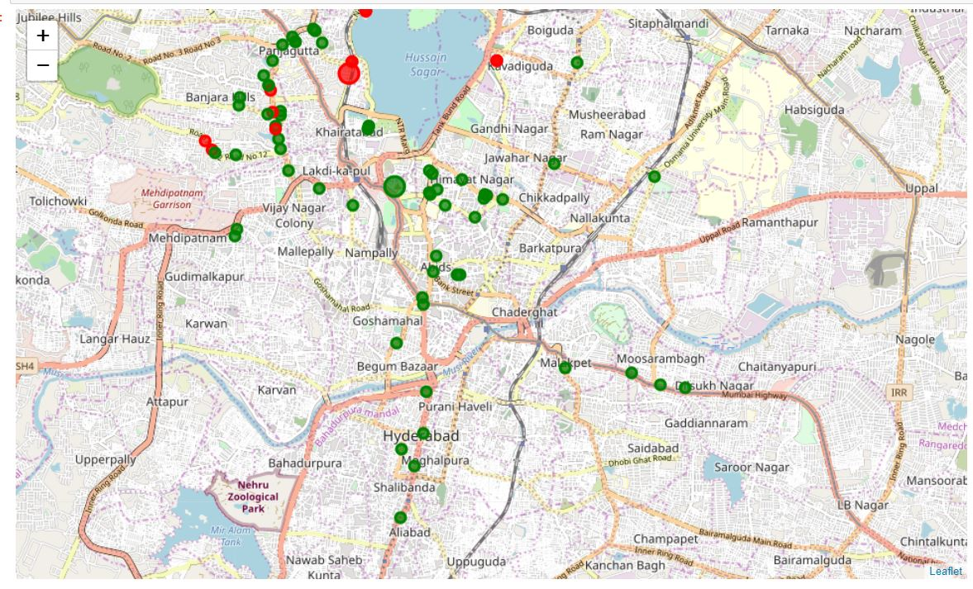
RESULTS
Categorized the venues into 3 Clusters:
Cluster 0 : The first cluster (green) is spread across the whole city and includes the majority venues. These venues have mean price range of 1.70 and rating spread around 3.86.
Cluster 1: The second cluster (red) is very sparsely spread and has very limited venues. These venues have mean price range of 3.54 and rating spread around 4.32.

Slide 6
DISCUSSIONS
We identified that from the total set of venues, majority of them were Indian Restaurants and Cafes
A visitor who loves Indian Restaurants would surely benefit from coming to Hyderabad.
When we plot these venues based on ratings, we discover that there are clusters of venues around Panjagutta, Himayatnagar , Abids . These clusters also have very high ratings.
On plotting the venues based on their price range on the map, we discovered that venues located near Abids are relatively priced lower than venues in Himayatnagar. A mix of medium price and high price exist in Banjara Hills and Panjagutta.

Slide 7
recommendations
Finally when a person is looking for cheap places with relatively high rating, you should check Abids
If you're looking for the best places, with the highest rating but might also carry a high price tag, you should visit Himayatnagar.
If you're looking to explore the city and have no specific criteria to decide upon the places you want to visit, you should try Punjagutta.

Slide 8
Conclusion
The purpose of this project was to explore the places that a person visiting Hyderabad could visit
The venues have been identified using Foursquare and Zomato API and have been plotted on the map
The map reveals that there are major areas a person can visit: Panjagutta, Banjara Hills, Himayatnagar, Abids
Based on the visitor's venue rating and price requirements, he/she can choose amongst the three places.

Slide 9

THANKYOU

